Slide 1
The 100 Day Test
Post-Inauguration Insights and Policy Changes Under the New Trump Administration
Informa Pharma Intelligence Editorial Team
Platinum Partner Meeting
April 5, 2017

Slide 2
Today’s Agenda
Presidential Governance 101
Economics – The Trump Bounce?
Timeline – A New President’s First 100 Days
Scorecard on “The Gettysburg Contract”
Impact and Implications for key Business Segments
What to Do?
Biopharma’s Reputation in a Post-Fact World
Upcoming Content from Informa Pharma Intelligence

Slide 3
Presidential Governance 101
Does the Man Make the Office or Does the Office Make the Man?
Enumerated Powers of the Presidency
“A Republic…If You Can Keep It”
Competence + Character = Credibility
Trust is the currency of power
Real story of Trump Presidency so far – Constitutional checks and balances still work
Executive Orders: a road to nowhere?
Necessity for bipartisan solutions
Commander-in-Chief
Negotiate treaties
Make official appointments
Present the State of the Union

Slide 4
The Trump Bounce
Key Economic Indicators are on the Rise
Trends Align with Trump’s Core Campaign Promise
Lifting incomes of the American worker – job security
The Wild Card: New Business Investment
Companies are hoarding cash
Prospects for the Trump agenda driving investment risk
Labor force participation +
Hourly manufacturing earnings +
Dow Jones record high March 1 +
GDP 2017 forecast higher than 2016’s anemic 1.6% +

Slide 5
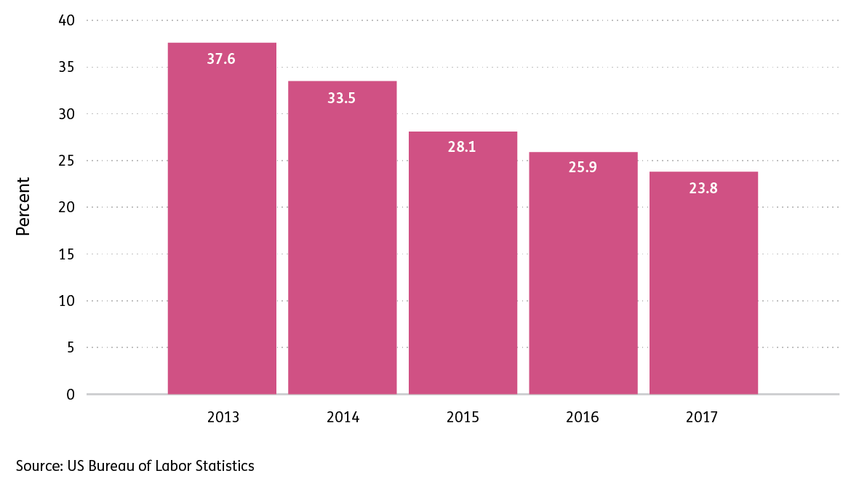
US Long-Term Unemployment Rate: Percent of Total

Slide 6
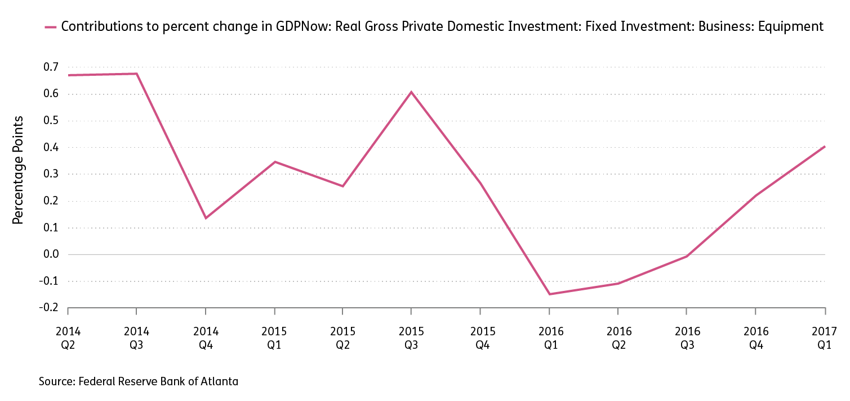
New Business Investment

Slide 7
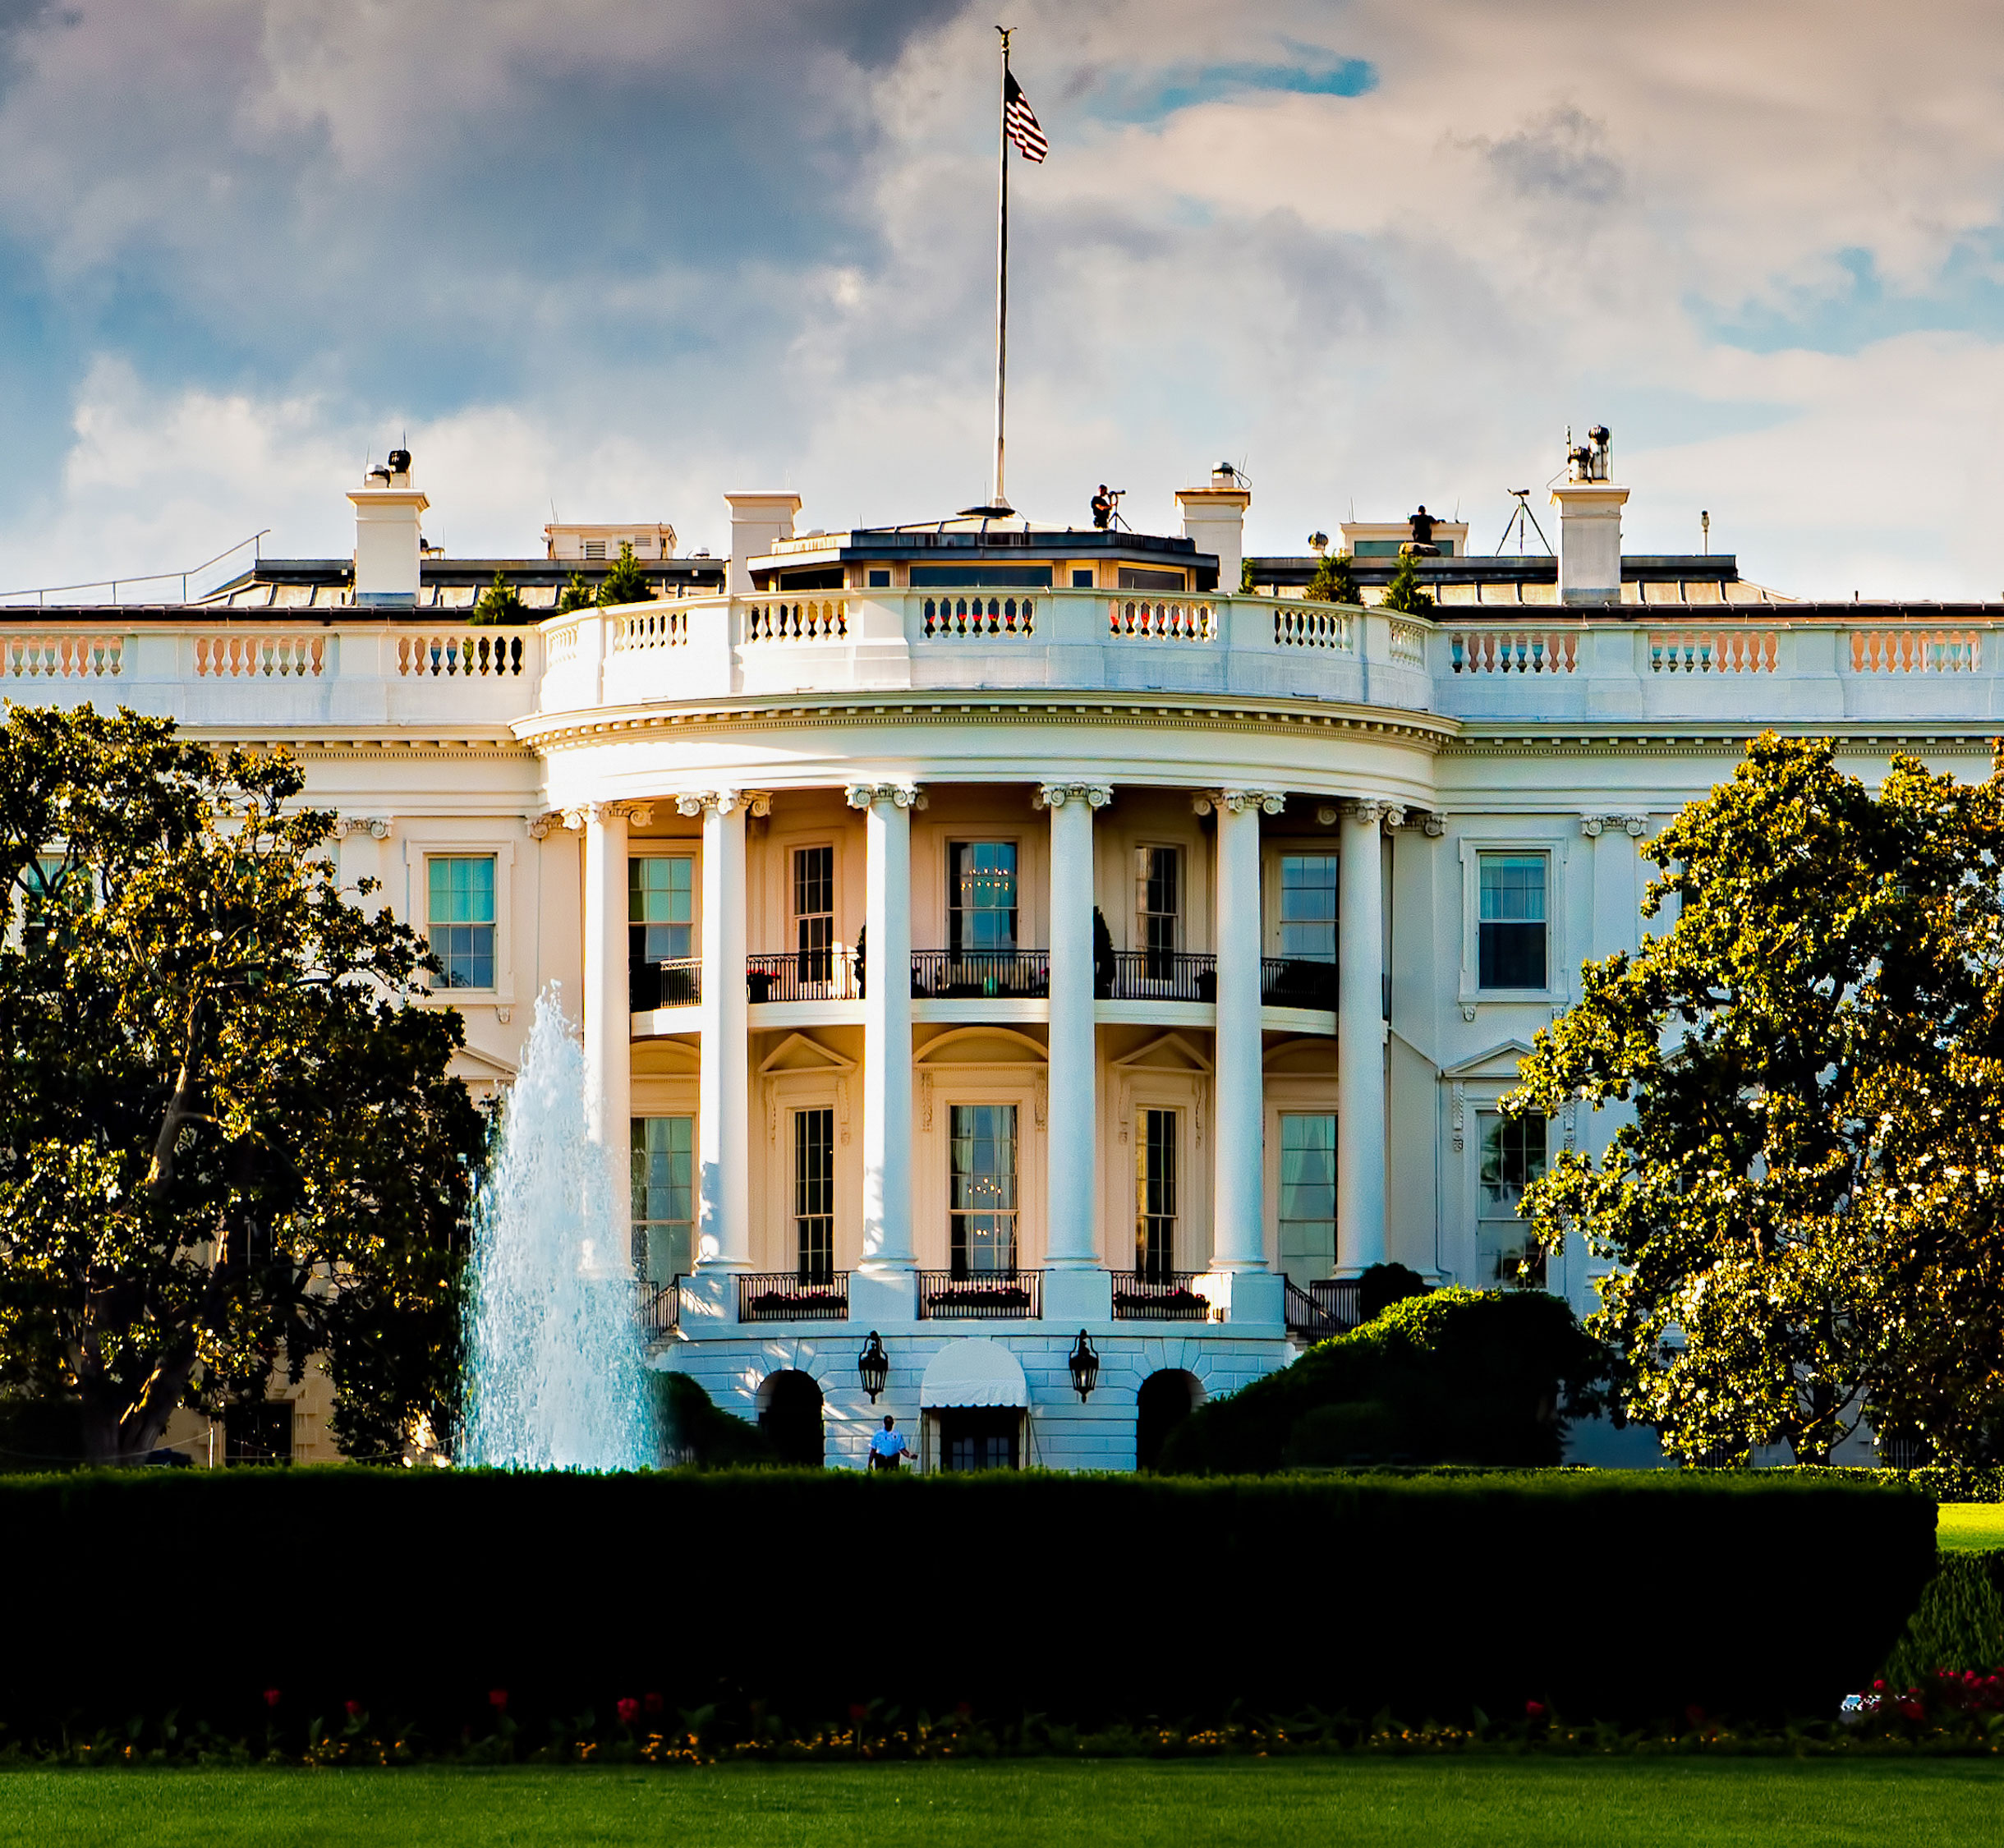
Trump’s first 100 days
E.O. on regulatory reform review
Trump meets health insurers at WH
Trump, Rep. Cummings meet on Rx pricing
HR 1628 American Health Care Act introduced
Inauguration Day
163 Biotech CEOs contest immigration ban E.O.
Vote American Health Care Act postponed
Trump speech to Congress
Fed debt limit expires
Trump meets Bill Gates
20 of 22 Cabinet heads confirmed
2017
January
February
March
April
Gorsuch nominated Supreme Court
David Price confirmed as HHS Secretary
G-20 abandons free trade endorsement
GA special House election
E.O. renounces TPP pact
Dr. Scott Gottlieb nominated as FDA Commissioner
Polls show majority disapproval of Trump record so far
Seema Verma confirmed as CMS Administrator
Continuing Budget Resolution Expires
Drug CEOs meet Trump at WH

Slide 8
Trump’s Contract with the American Voter - I
Protecting American Workers | Status
Renegotiate NAFTA or withdraw | Pending
Renounce Trans-Pacific Partnership | Yes
Declare China a currency manipulator | No
Commerce and USTR to target foreign trade abuses | Pending
Restore National Security and Rule of Law | Status
For every new federal regulation, eliminate two | Yes
Cancel job-killing Obama Executive Orders | Yes
Hiring freeze on federal workforce | Yes
Nominate new Supreme Court justice | Yes
Suspend immigration from “terror prone” regions | Delayed
Build Mexico border wall | Proposed
Deport illegal immigrants with criminal records | Yes

Slide 9
Trump’s Contract with the American Voter - II
Advancing Jobs and Economic Growth | Status
Middle-Class Tax Relief and Simplification Act - Reduce 7 income tax brackets to 3 - Cut corporate tax rate to 15% from 35% - Repatriate corp. overseas profits at 10% rate | Proposed
Disincentivize offshoring of US manufacturing jobs | Proposed
American Energy & Infrastructure Act: $1 trillion/10 yr | Proposed
Build Keystone oil pipeline | Yes
Choice and Access to Health Care | Status
Repeal and Replace Obama’s Affordable Care Act | No but…
Speed Approval of Life-Saving Medicines – FDA reform | Pending

Slide 10
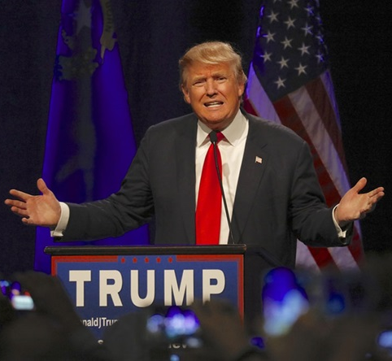
President Trump: Pharma Is Just As Confused As Everyone Else
Insight from
Trump’s rhetoric continues to be distressing, and as he continues his campaign-style rallies, expect more statements like what he said in Kentucky last month: “The cost of medicine in this country is outrageous, many times higher than in some countries in Europe and elsewhere.”
But the context of Trump’ speech is significant. He was stumping for a health insurance reform bill that didn’t have any Rx pricing language – and the bill didn’t pass.

Slide 11
Deal Making: All Eyes on the U.S.
Big pharma transactions rebound
Cash rich
Pipeline productivity: Shortage of organic products to spur growth
Potential payoff from U.S. tax reform and regulatory changes
Slowdown in mid-level specialty segment
Datamonitor Healthcare’s mid-pharma peer set
M&A hangover: increasing debt loads
Competition for market-ready assets: Arms race in oncology
Freeze on inversions
Ongoing strategic drivers
New asset plays in big data/analytics and machine learning
Get global: de-risking with geographies and a dominant therapeutic franchise
Revival of deals focused on swapping assets aligned to the core
Size and Scale count
Soaring cost of drug development and commercialization, especially in U.S

Slide 12
Medtech Under the Radar – So Far
Medtech gets less attention than pharma on “public shaming” front – but core industry issues are still in play
2.3% devices excise tax to fund Obamacare – Repeal in jeopardy?
FDA user fees [MDUFA IV] – Industry as “payer of first resort”
Medtech shares are holding up
Hospital stocks – devices’ key customer – rally on AHCA withdrawal
Next steps on health reform, post-AHCA
Political distractions imperil Process innovation – Will momentum slow for
industry/provider partnerships focused on outcomes? (i.e. J&J CareAdvantage)
Potential positives on the approval front
FDA nominee Gottlieb favors more flexibility on evidence requirements

Slide 13
Health Reform: Post AHCA Issues
March to Health Care as an Entitlement resumes…for now
Medicaid now covers one of every five Americans
Will more GOP-led states opt in to Obamacare's expanded Medicaid subsidies?
Stability test for Obamacare public/individual insurance exchanges
The problem: Weak individual mandate coupled with Strong adverse selection
Big commercial insurers have abandoned the exchange market
April-June deadline looms for insurer participation for 2018
Regulation as a GOP reform tool
HHS Sec. Price offers states Section 1362 “innovation” waivers for new insurance models
Wild Cards
Employers step up – Health Transformation Initiative pilot project on drug purchasing
CHIPS program reauthorization – a bipartisan pact?
Bottom Line for Biopharma
Reform will not deliver first dollar coverage for drugs
ACA’s $90 billion tax on industry stays in place

Slide 14
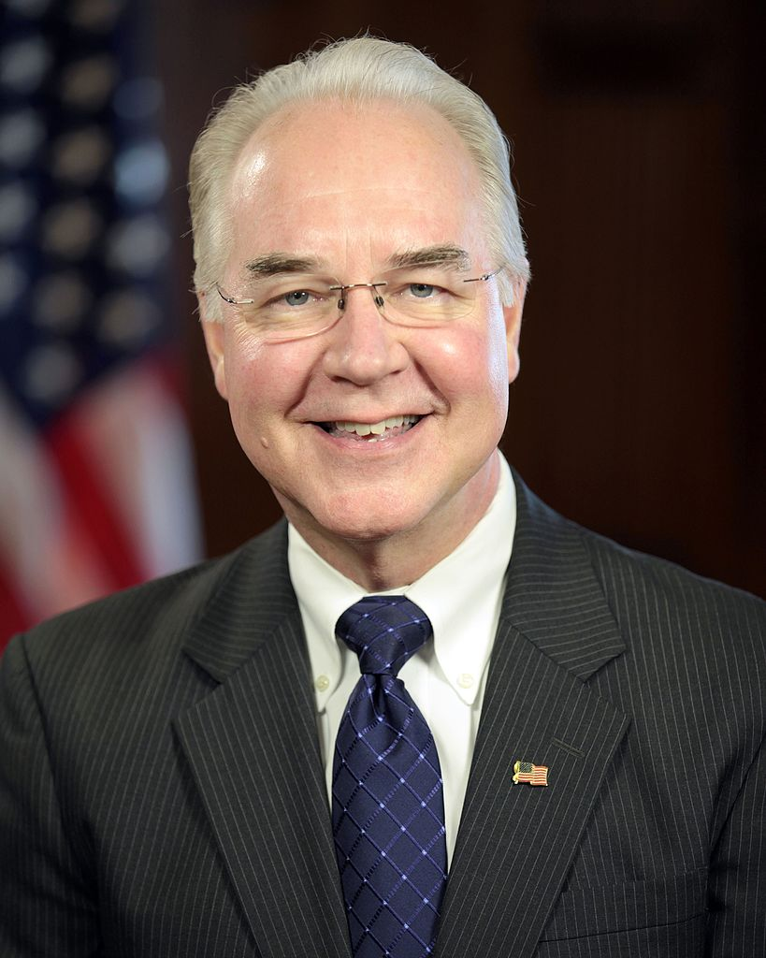
FDA Commissioner Nominee Reassuring
Medical product firms breathed a sigh of relief with the selection of Scott Gottlieb to be FDA Commissioner. President Trump had been considering more disruptive choices, so the selection of Gottlieb, who served as a deputy commissioner during the George W. Bush administration, should give industry some reassurance that Trump’s FDA will be a reform-minded but not radical institution.
Similarly, HHS Secretary Tom Price holds mainstream Republican views of health policy, even if they don’t align perfectly with the pharma industry’s priorities.

Slide 15
Tax and Trade
Trump’s plan for deep and radical tax reform faces stiff resistance
Skyrocketing federal debt and deficit forecasts
Proposed tax on imports guarantees a partisan food fight
Savings from failed health reform and a no-go import tax reduces budget baseline for tax reductions by $2 trillion
Trump’s 15% corporate rate? Try Obama’s 28%
One bargaining chip: repatriation of biopharma’s $450 billion in profits held abroad
Trade Policy – a President’s Prerogative
Trump has substantial autonomy to act on abuses
But “America First” tone is already softening
Biopharma may cede the benefits from multilateral initiatives like TRIPS

Slide 16
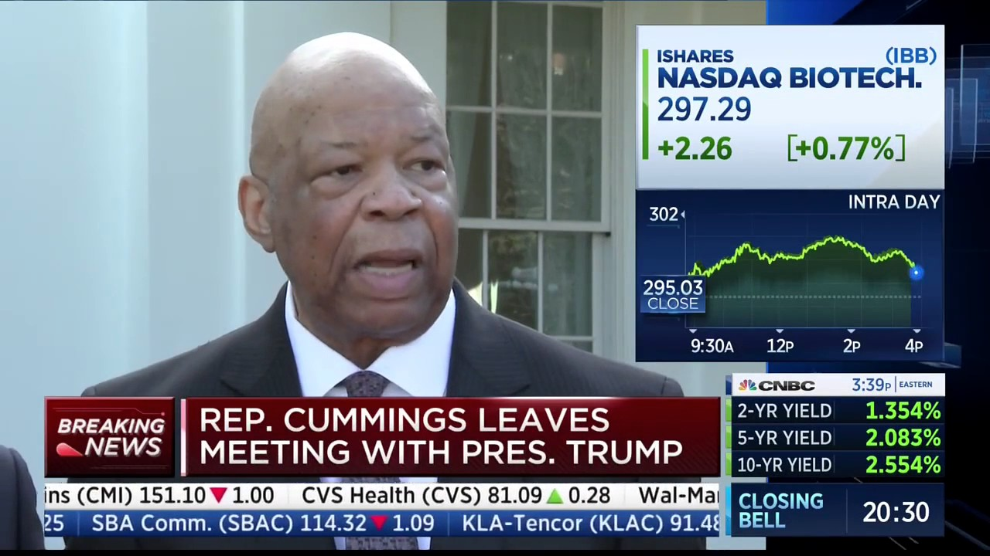
If Trump Works With Democrats, Pharma Could Be In Trouble
The collapse of the Republican’s health insurance reform bill has raised questions about the viability of the rest of the their legislative agenda, but they are much more in alignment with each other – and with the pharmaceutical industry – on tax reform issues, so that could be easier to pass if they overcome their concerns on deficit spending. Tax provisions allowing reparation could fuel a deal-making boom for the industry.
If Trump wants a healthcare accomplishment, though, it seems he will have to negotiate with Democrats, and in that deal Pharma will be on the menu, not at the table.

Slide 17
What to Do?
Reputation Management: the vox populi factor
Social media and the street
A global company in crisis: Who do I call?
Don’t be stateless
Diversity and Inclusion more important than ever
Risk Intelligence: new addition to the C-suite
Support collaborative science – climate change as a litmus test
Reassessment of outsourcing and the global supply chain
Vendor control
Focus on the three cores of leadership
People
Strategy
Values
Understand your subsidies
scrutiny of PAP and beyond-the- pill services

Slide 18
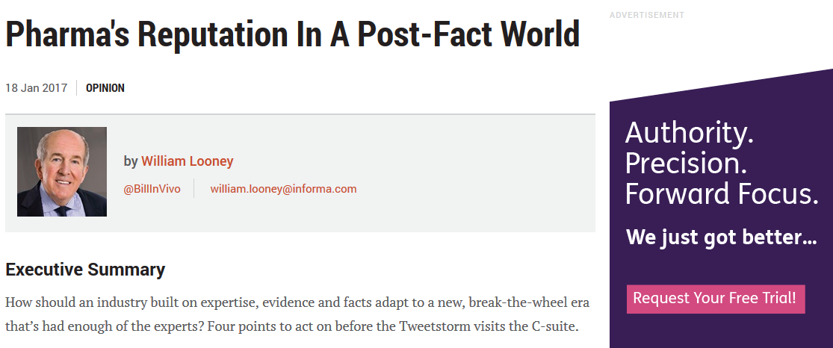
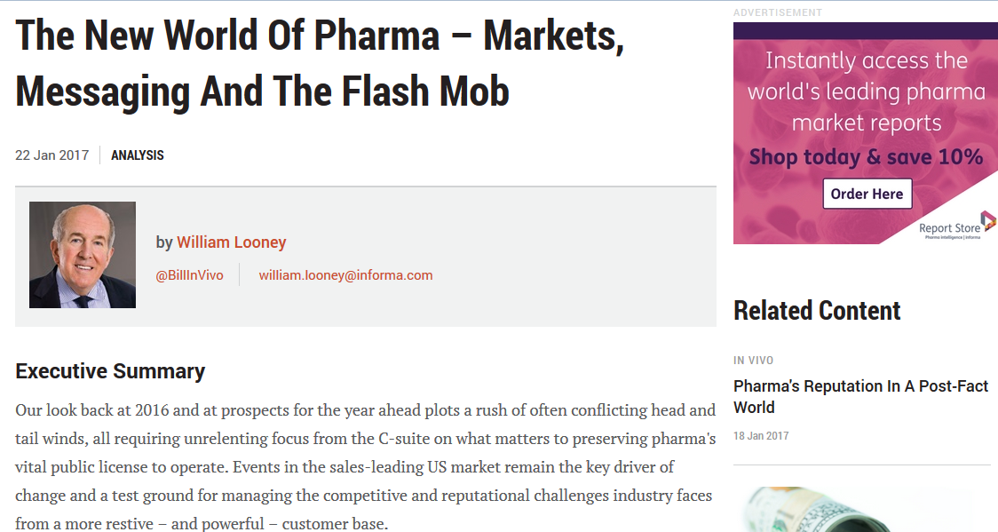
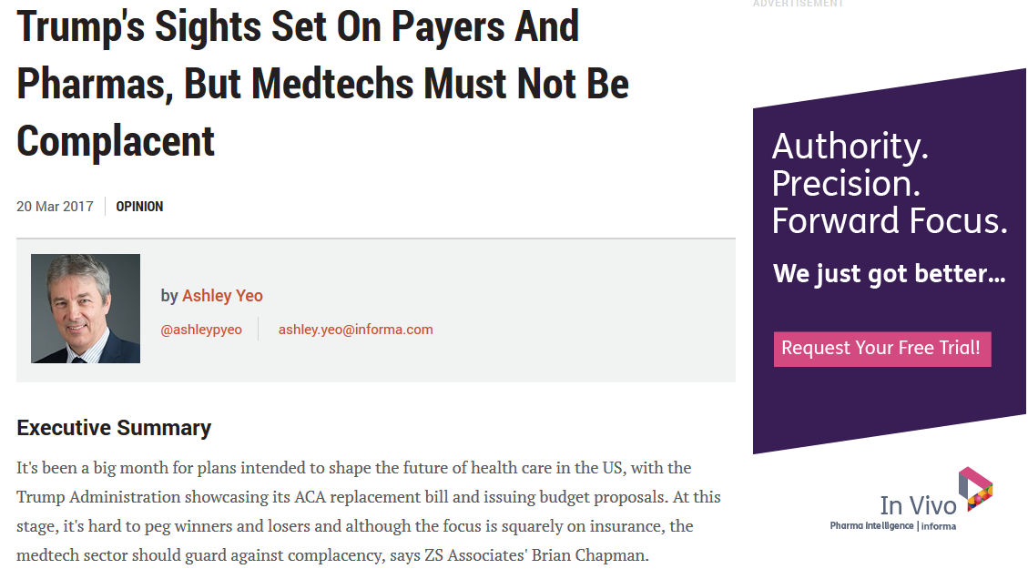
Trump – In Vivo’s Opinion & Analysis
In Vivo’s editorial team has provided in-depth analysis and opinion on the Trump Administration’s potential impact on the biopharma and medtech industries.

Slide 19
In Vivo Survey Series
Biopharma: The Future of Human Capital
Comprehensive CEO and C-Suite Questionnaire
Executive Feedback Panel
White Paper on Findings and Recommendations
Roll Out at May 22, 2017 BIO-Equity Conference
In Vivo feature presentation
Health Reform and Biotech
CEO survey: What’s the best service delivery and financing model to support future innovation?
Identify key stakeholder pain points in market access negotiations: room for consensus?
Pricing in the US vs. Europe – for and against
Competitive free-for-all…
Or the managed market?

Slide 20
Thank you!
William.looney@informa.com

